Slide 1

Emotional Intelligence (EQ) for Executives Why is it important for leaders?
Austin Makwaia Makani
Founder CEO, AMM Investment

Slide 2
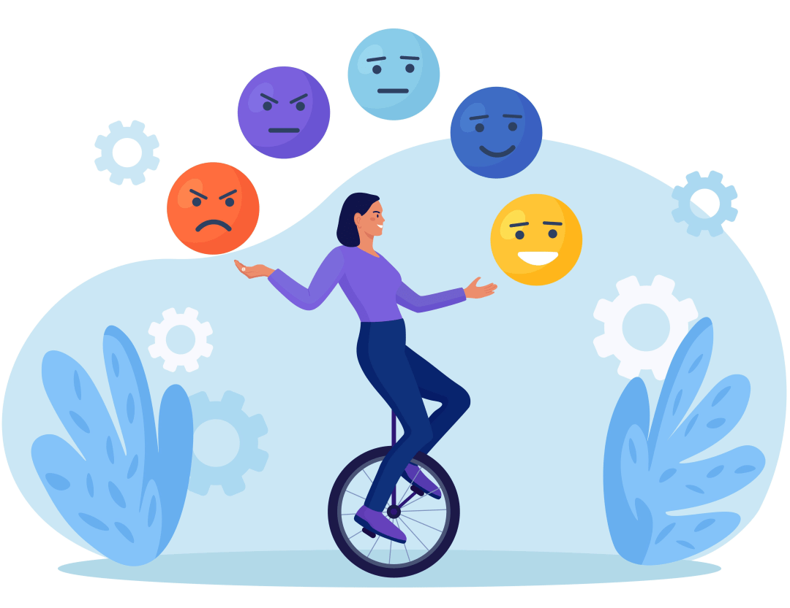
Understanding Intelligences
1. Intelligence Quotient (IQ): This is the measure of your comprehension ability", solve maths; memorize things and recall subject matters.
2. Emotional Quotient (EQ): This is the measure of your ability to maintain peace with others; keep to time; be responsible; be honest; respect boundaries; be humble, genuine and considerate.
3. Social Quotient (SQ): This is the measure of your ability to build a network of friends and maintain it over a long period of time.
4. The Adversity Quotient (AQ): The measure of your ability to go through a rough patch in life and come out without losing your mind. AQ determines who will give up in face of troubles and may abandon their families.

Slide 3

Thoughts to Ponder
A man of high IQ can end up being employed by a man of high EQ and SQ even though he has an average IQ. Your EQ represents your character; your SQ represents your charisma. Give in to habits that will improve these three Qs but more especially your EQ and SQ EQ and SQ make one manage better than the other.
People that have higher EQ and SQ tend to go farther in life than those with high IQ. Most schools capitalize in improving IQ level while EQ and SQ are played down.

Slide 4
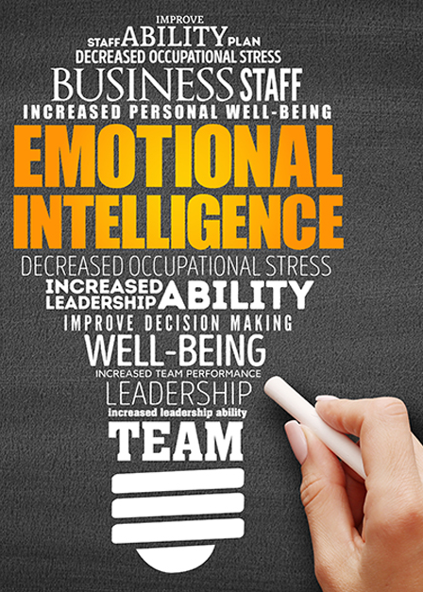
EQ Defined
Human ability to recognize, understand, exploit and manage one’s emotions in positive way.
It is being cognizant of your mental state and how it influences the emotional reactions of those around you.
Ability to connect emotionally with teams, how you make them feel, engage and ultimately it’s impact on productivity, through:
Change and Uncertainty
Interactions with Colleagues
Conflict and Relationship
Effort and Burnout
Achievement and Failure

Slide 5

Significance
EQ is critical to:
Connect with Team
Drive Performance
Build Trust

Slide 6

Understand where you stand
Government’s Vision
Ministry’s Vision and Mission
Agency’s Vision and Mission
CEO
Management
Staff
Support Team

Slide 7

Distinction
The most effective leaders are all alike in one crucial way – They all have a high degree of what has come to be known as EQ. It is not the IQ and technical skills that are solely relevant. These are simply entry-level requirements for executive positions. However to excel horizontally and vertically, EQ is your boarding pass!!
Daniel Goleman and Austin Makani

Slide 8

Important QNs to ask yourself (assessment)
Are you conversations strained?
Do you constantly blame others when things do not go as planned?
Are you prone to outbursts?

Slide 9
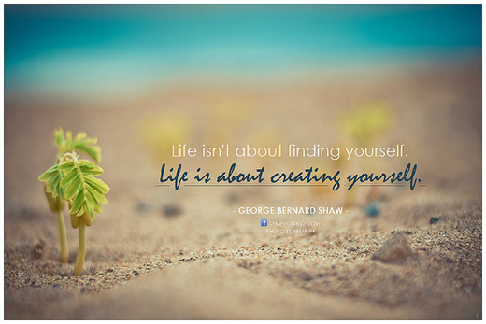
How to develop EQ
Self reflection (own emptions, thoughts and behaviors)
Active listening (not hearing) – verbally and nonverbally
Empathy Practice (understand and share other’s feelings)
Seeking Feedback (on your conduct – not Uchawa)
EQ Training (gain competencies)
Four Rs of EQ: Recognize – Reflect – Reframe – Respond!!

Slide 10
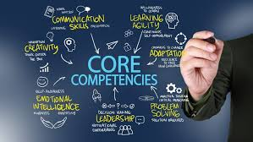
Competencies
4 core competencies of EQ
Self Awareness (95% Vs. 10% – 15%). Bring the best of yourself first before you bring the best out of others
Self Management (manage your emotions especially during stressful situation, maintain positive outlook despite setbacks, proactiveness vs. reactiveness)
Social Awareness: ability to recognize other’s emotions and their dynamics within your organization
Relationship Management: Ability to influence, coach and mentor others and resolve issues effectively.

Slide 11
Benefits
Improved communication and team dynamics (effective communication and collaborative work environment)
Enhanced Leadership Effectiveness (inspire and motivate, manage relationships, create culture of high performance)
Improved Decision-Making (when you understand and consider other’s perspectives, it helps you to make better choices aligned with organization’s goals and values)
Increased self-awareness and self-regulations (understanding own strength and weaknesses, manage reactions in challenging situation and remain calm under pressure)
Empathy and Social Skills (connect with teams at personal level, build trust and foster sense of belonging)
Building Resilient Teams (through a safe and supportive environment your team becomes better equipped to handle challenges.)

Slide 12

EQ can enhance your ability to manage interpersonal relationships, which is crucial for fostering positive team dynamics, empathy and effective collaborations.
Empathy and Inclusion are imperative for organizational growth, prosperity and diversity for success
Lets grasp EQ through a brief video

Slide 13
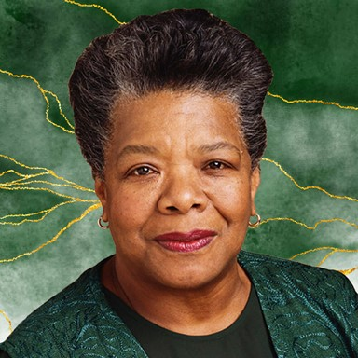
Thank you for your attention. Lets Go and Bring out the Best
“I have learnt that people will forget what you said, people will forget what you did, but people will never forget how you made them feel”
Maya Angelou

